Slide 1
Worthy of All Worship
Revelation 4
Lewis Winkler • Crossroads International Church • BibleStudyDownloads.org

Slide 2
Revelation
Sovereignty of Christ in Future Victory
Sovereignty in His Person |  |  | Sovereignty over Churches | Sovereignty in End-Time Events
Chapter 1 |  |  | Chapters 2–3 | Chapters 4–22
"What you have seen" (1:19a) |  |  | "What is now" (1:19b) | "What will take place later" (1:19c)
Past |  |  | Present | Future
Christ Unveiled |  |  | Churches Unveiled | Consummation Unveiled
God on Earth |  |  | God's Ambassadors on Earth | Hell on Earth to Heaven on Earth
The Judge |  |  | The Assignments | The Judgments & Rewards
Subject 1:1-3 | Worship of Trinity 1:4-8 | Glorified Christ 1:9-20 | Seven Churches of Asia: Ephesus Smyrna Pergamum Thyatira Sardis Philadelphia Laodicea | Tribulation 4:1–19:10 | Second Coming 19:11-21 | Millennium 20 | Eternal State 21:1–22:5 | Closing: Imminency 22:6-21
AD 95

Slide 3
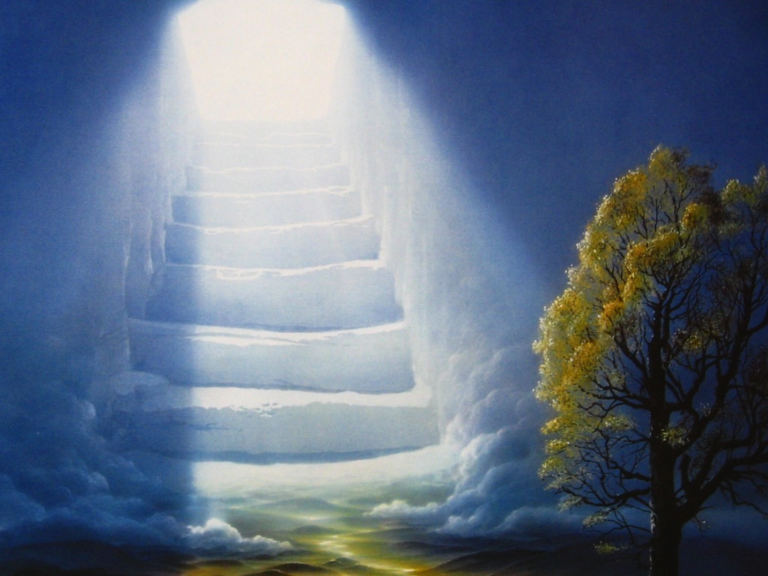
“I looked and behold, a door standing open in heaven!” (4:1a)

Slide 4
“Come up here, and I will show you what must take place after this” (4:1b)

Slide 5
I. An Invitation to Knowledge (4:1)
John is given the exceedingly rare chance to get a glimpse of heaven.
John is also given the exceedingly rare chance to know the future.

Slide 6
Some Food for Thought
If God gave you an invitation to know the future, what would you want Him to reveal to you?

Slide 7
An Invitation to Wonder (4:2-8a)

Slide 8
An Invitation to Wonder (4:2-8a)
“At once I was in the Spirit . . . .”

Slide 9
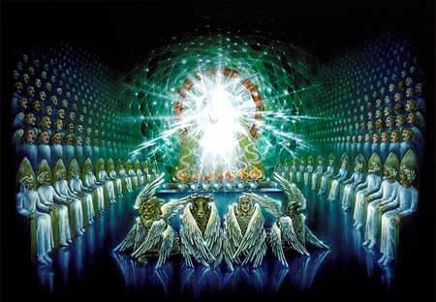

Slide 10
Who are the 24 elders (4:4)?
Angelic Beings?
The 12 Tribes and the 12 Apostles?
A Symbolic Representation of all the Saints?

Slide 11
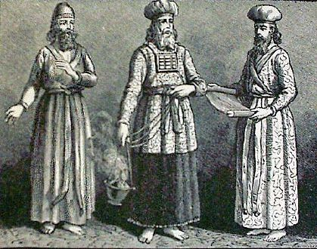
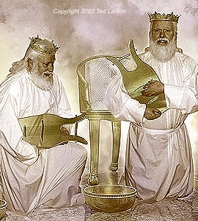
Who are the 24 elders (4:4)?
They are likely parallel to the Aaronic Priesthood
24 Priestly Orders
(1 Chron. 24)
24 Elders
(Rev. 4:4, 10)

Slide 12
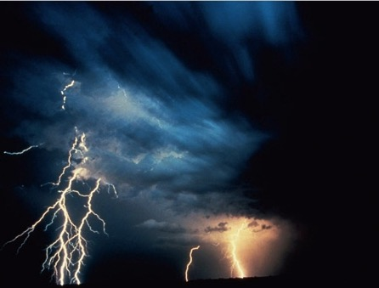
“From the throne came flashes of lightening, rumblings and peals of thunder” (4:5a)

Slide 14
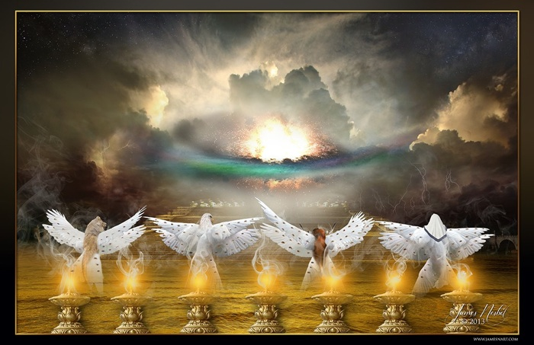

Slide 15
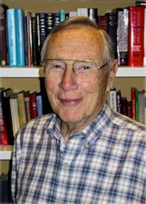
An Invitation to Wonder (4:2-8a)
“The visions . . . were meant to stir the imagination, not yield to the drawing board.”
—Robert Mounce

Slide 16
Some Food for Thought
When was the last time you took some time to really reflect upon the awesome power, majesty, and authority of God?
More specifically, when was the last time you contemplated yourself standing before the wondrous throne of God?

Slide 17
An Invitation to Worship (4:8b-11)

Slide 18
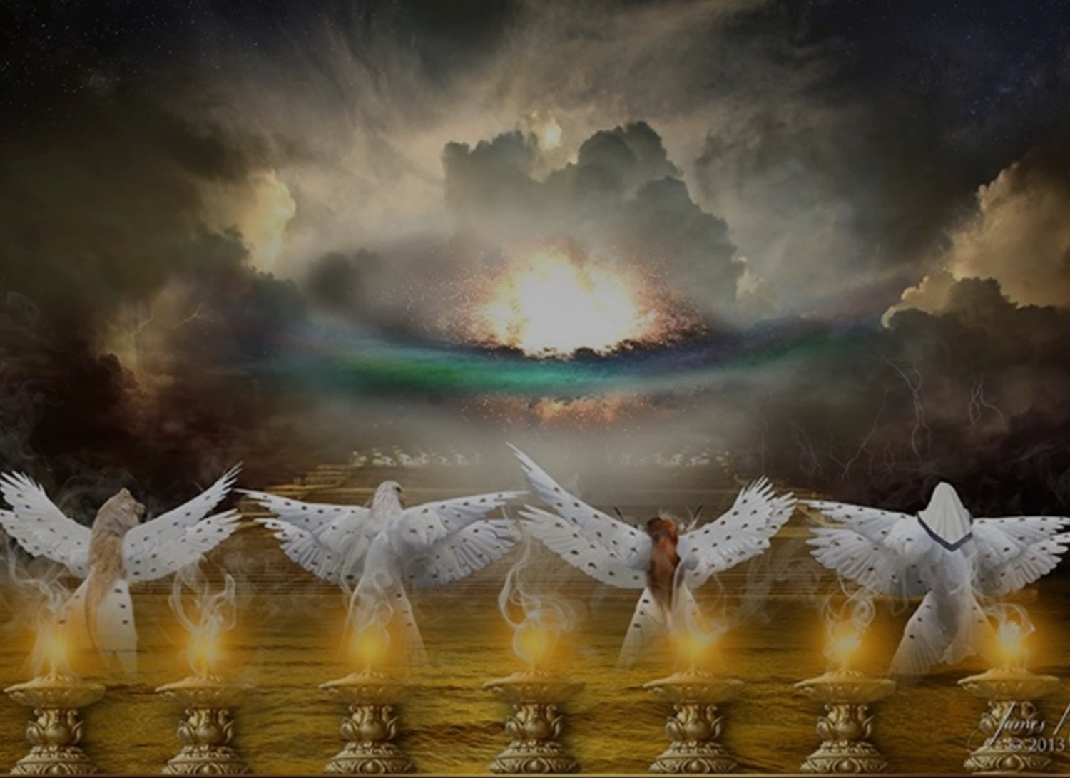
An Invitation to Worship (4:8b-11)
“Holy, holy, holy, is the Lord God Almighty, who was and is and is to come!”

Slide 19
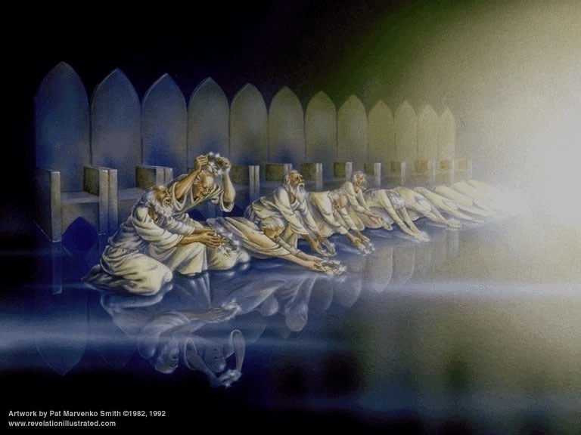
An Invitation to Worship (4:8b-11)
“Worthy are you, our Lord and God, to receive glory and honor and power, for you created all things, and by your will they existed and were created.”

Slide 20
Conclusion and Application

Slide 21
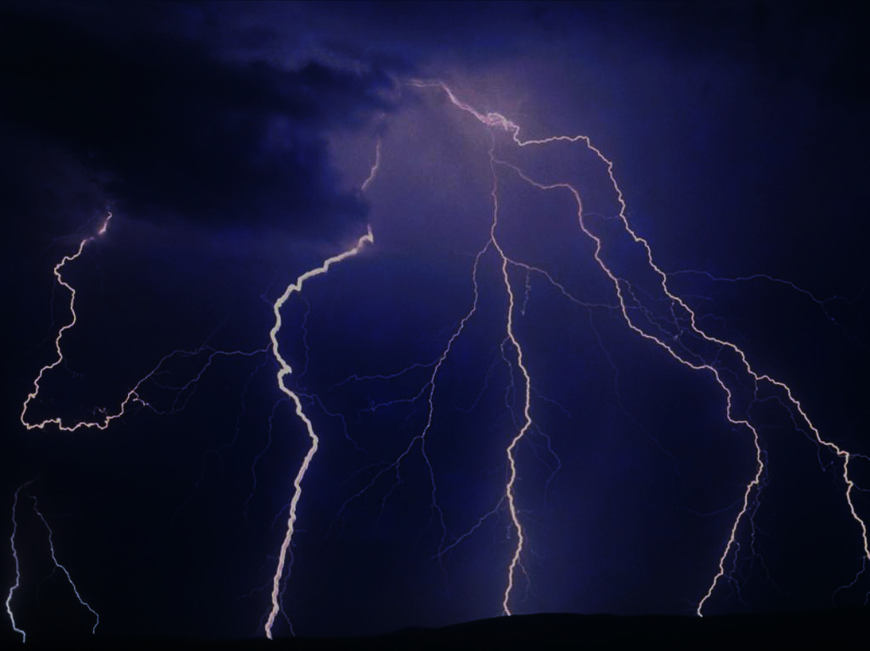
Main Idea:
God, the wondrous and sovereign Creator of all, is worthy of all worship.

Slide 22
Conclusion and Application
What do your spend most of your time doing and thinking about and how do you spend most of your money?
In view of this, who or what are you putting your trust and hope in to get you through the tough times of life?
What will you do to reorient your life towards a greater trust in and worship of God?

Slide 23
Black

Slide 24
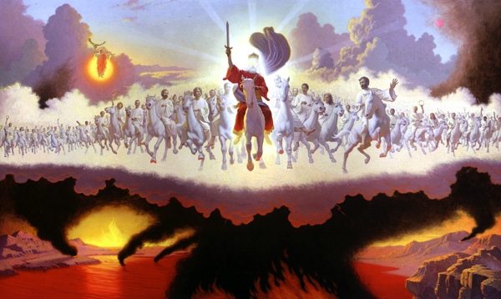
Jesus Wins!
Series on Revelation

Slide 25
NT Sermons link at biblestudydownloads.com
Get this presentation for free!

